Slide 1
Khoj Newsletter
Grade: 8A
November 03, 2022

Slide 2
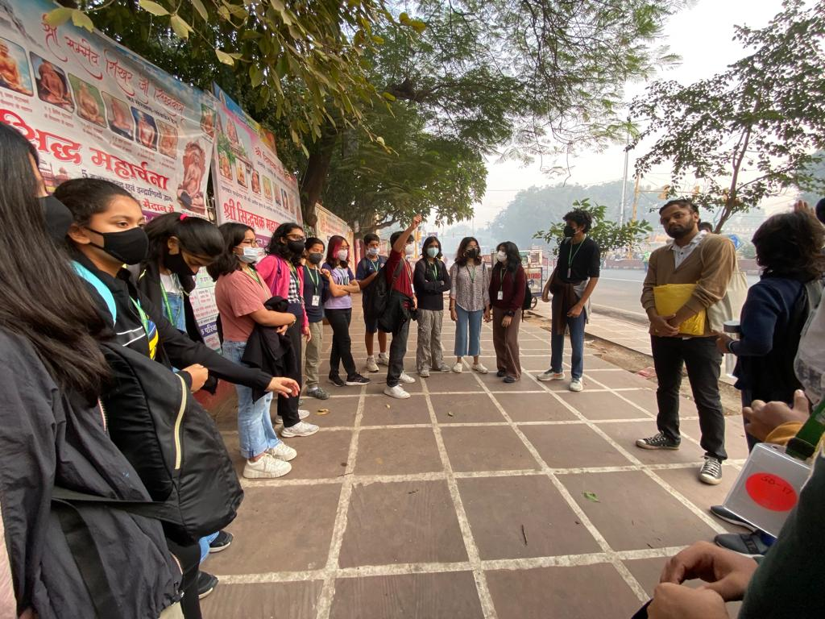
The students of 8A began their day with a context setting in Chandni Chowk. They were asked to imagine themselves as British who have just suppressed the revolt. They then discussed what their plans would be in order to change the city for political outcomes in their favour.
Starting the session with recapitulation
on Revolt of 1857

Slide 3
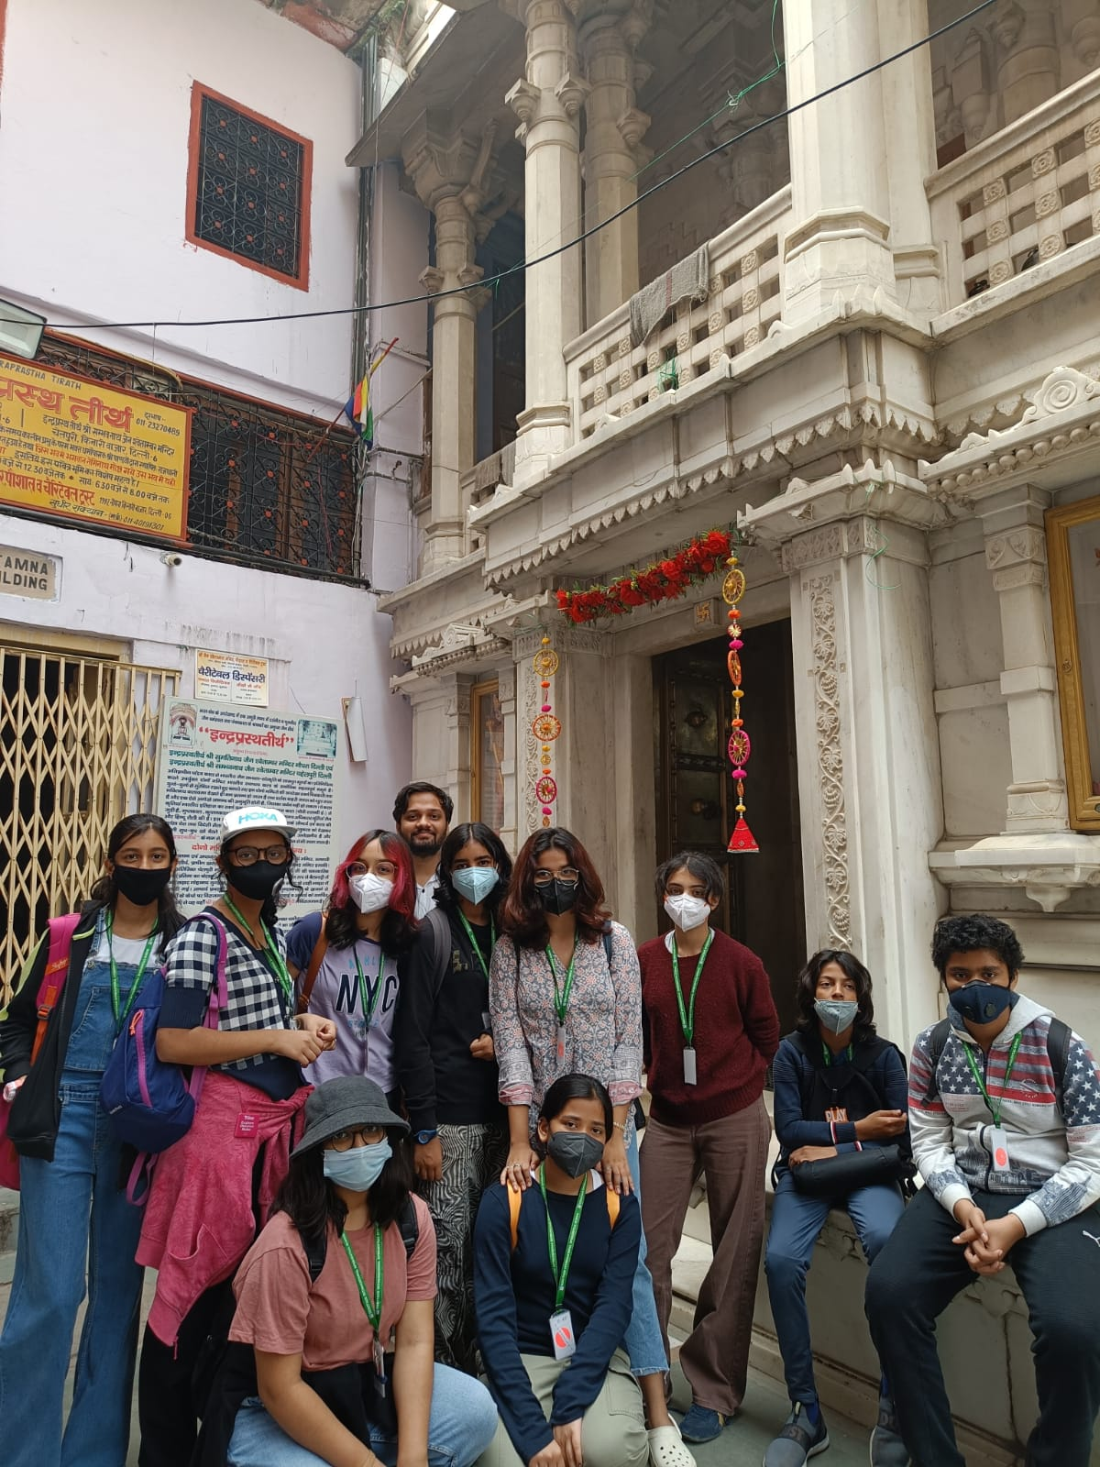
They then went to the Digambar Jain Mandir, also known as the Urdu Mandir. A short walk helped them enrich their understanding of the multi-religious settlement in Shahjahanabad, to build values of co-existence and tolerance.
Chandni Chowk offered them a clear juxtaposition of Indian architecture with the British one and students could make comparisons of the two. They were also able to observe firsthand examples of neo-classical architecture. Students held a discussion around the role of money lenders and how it influenced Shahjahanabad post revolt, the creation of Imperial Bank of India and co-influence of JM Keynes.
Outside the Shwetambar Jain Mandir

Slide 4
An interesting conversation about Begum Samru and her son (David Ochterlony) led to exploration of how the British could also be obsessed with the Mughals whilst calling themselves superior. Residential spaces at Naughara Chowk presented them with specimens of domestic architecture of the time. Breakfast was an exploration of Parathe Wali Gali.
The cohort has now moved to Connaught Place where, after lunch, the focus will be on British planning and architecture as a method of establishing their impact on an otherwise Mughal city.

Slide 5
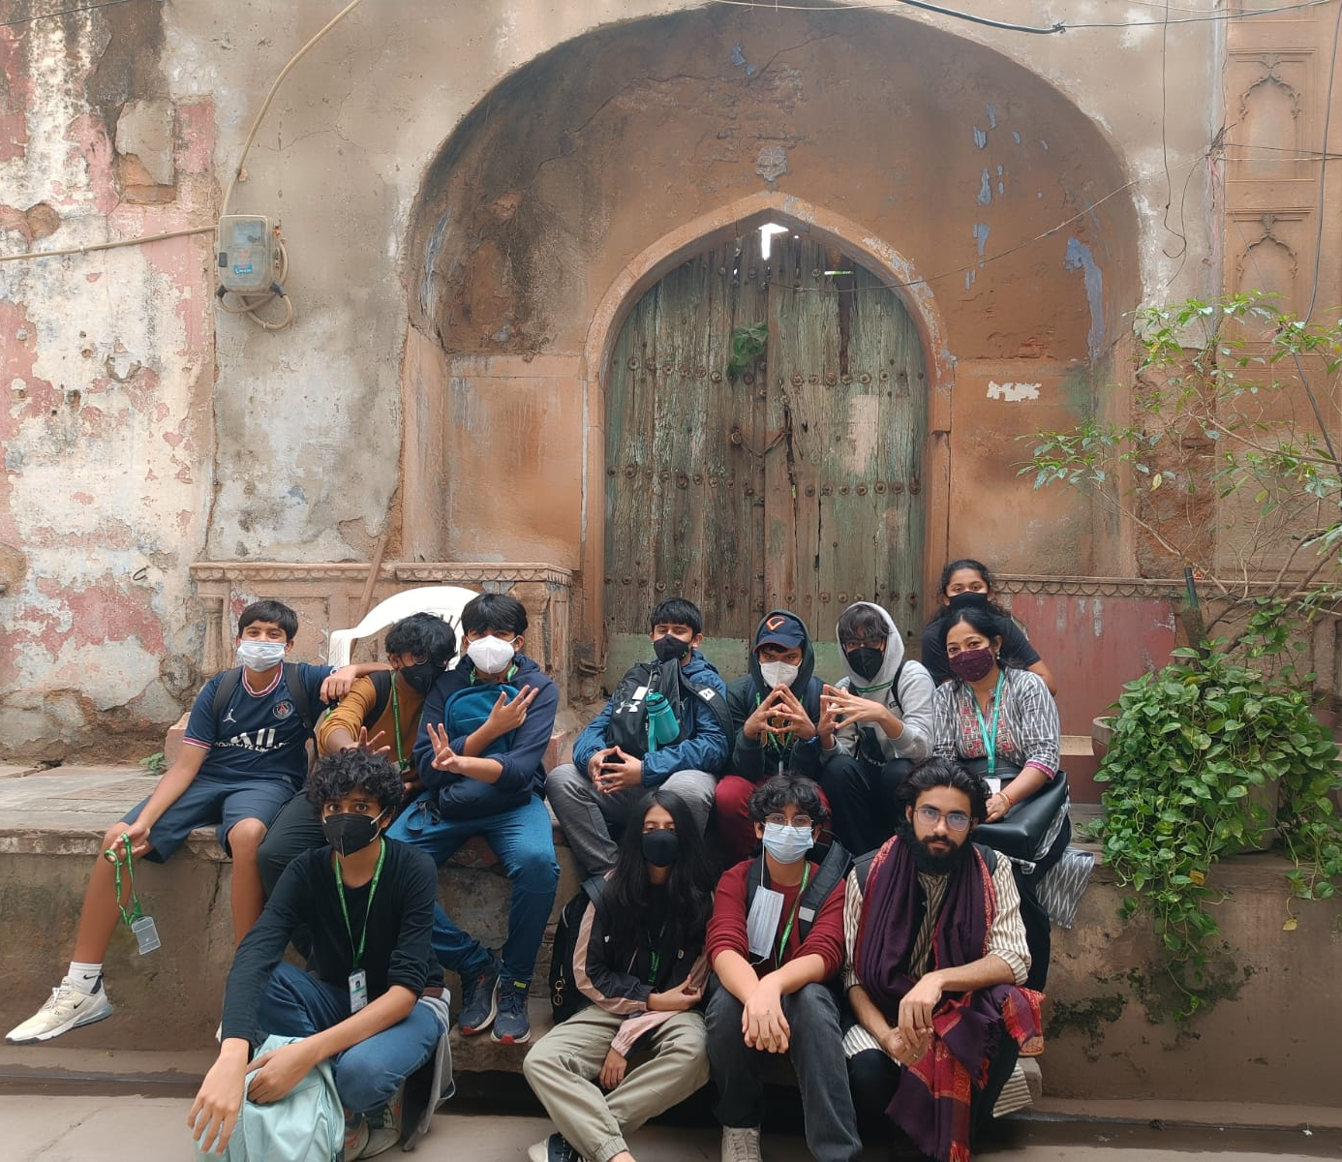
This will segue into discussions around the British plans to quell future revolts or rebellions. They will also simultaneously consider the continuity and change of food culture from the times of Shahjahanabad. A comparison of the two seats of power- Red Fort and Rashtrapati Bhavan will be done once the students move to Raisina Hill and India Gate.

Slide 6
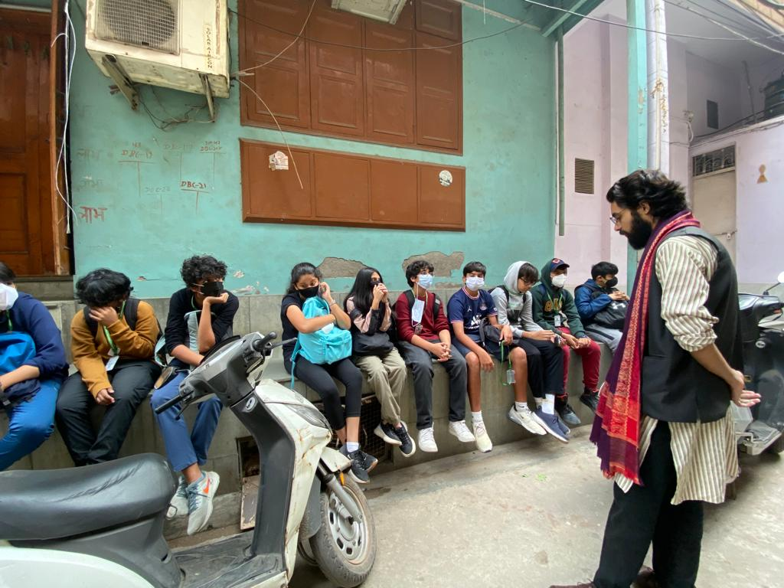
The students are participating well in the interesting conversations with relevance to their lived reality of Delhi. After a closing circle and refreshments, they will leave for school at 4:30 pm. We will update you about the exact time of arrival.

